Slide 1
Day1 PPT
1.COMPUTER ARCHITECTURE AND ALU DESIGN
2.OUTPUT UNIT
3.CONTROL UNIT
4.WHAT IS COMPUTER
5.FUNCTIONAL UNIT OF COMPUTER
6.INTODUCTION TO COMPUTER ARCHITECTURE
7.HOW ARE FUNCTIONAL UNIT CONNECTED
8.OPERATION OF CACHE
9.BUS STRUCTURES
10.PIPELINE

Slide 2
COMPUTER ARITHMATIC AND ALU DESIGN
Operations are executed in arithmetic and logic unit(ALU).
Arithmetic operations such as addition , subtraction.
Logic operations such as comparison of numbers.
In order to execute an instruction ,operands need to be brought into the ALU from the memory.
Operands are stored in general purpose registers available in the ALU.
Access times of general purpose registers are faster than cache
Results of the operations are stored back in the memory or retained in the processor for immediate use.

Slide 3
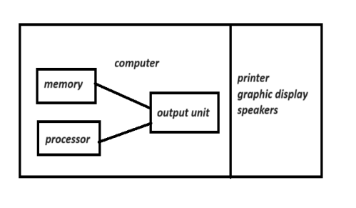
Output unit
In binary form computer represent information. Output Units:
Interface with output device
Accept processed results provided by computer in binary form
Convert that information in binary form to form understand by output device.

Slide 4
CONTROL UNIT
Operations of computer can be called as:
Accept information from the input units (input unit).
Stores the information in memory.
Process the information(ALU)
Provides processed result through output units

Slide 5
What is computer
Accepts input information
Processes information
Producing resulting output
Function that computer performed:
Accepting information to be processed as input
Storing a list of instruction
Processing information
Providing result

Slide 6
Functional unit of computer
Input
output
Memory
Inst1
Inst2
inst3
Aritmatic & logic
Control
processor

Slide 7
INTRODUCTION TO COMPUTER ARCHITECTURE
A modern meaning of the term computer architecture covers three aspects of computer design:
Instruction set architecture
Computer organization
Computer hardware
Instruction set architecture-ISA refers to actual programmer visible machine interface such as instruction set, registers , memory organization and exception handling.
Computer organization- Computer organization deals with how the various components of a computer system are arranged and interact to execute instructions. It's like the blueprint or layout of a building that determines how different rooms, corridors, and utilities are organized and connected.
In a computer system, this includes:
Memory Organization: How data is stored and accessed within the computer's memory. Think of it like how your brain organizes information in different sections for easy retrieval.
Processing Unit Structure: This involves the central processing unit (CPU), which is like the brain of the computer. It carries out instructions by performing arithmetic and logical operations on data.
Input and Output Mechanisms: How data gets into and out of the computer. This includes devices like keyboards, mice, monitors, and network interfaces.

Slide 8
Computer Hardware:
Computer hardware refers to all the physical components that make up a computer system. These are the tangible parts you can touch and see, like:
Central Processing Unit (CPU): Often referred to as the "brain" of the computer, the CPU performs calculations and executes instructions.
Memory (RAM): This is the short-term memory of the computer where data and programs are temporarily stored while the computer is running.
Storage Devices: Devices like hard disk drives (HDDs) or solid-state drives (SSDs) where data is permanently stored even when the computer is turned off.

Slide 9
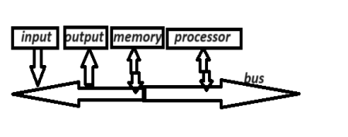
How are functional units connected?
To achieve its operation in computer , functional unit need to communicate to each other.
In order to communicate they have to stay connected
Bus is called group of parallel wires
Each wire in a bus can transfer one bit of information
Number of parallel wire is equal word length of computer

Slide 10
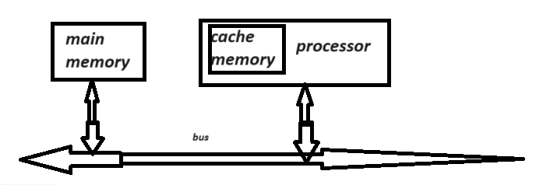
Organisation of cache

Slide 11
BUS STRUCTURES
A group of lines serves as a connecting path for many devices called a bus.
In addition to lines that carry the bus must have lines for address nd control purpose
To interconnect functional unit in simple way is to use simple bus

Slide 12
pipeline
It involves in parallel processing
Pipelining means its broken into sequence of pieces,where each piece is handled by different functional unit

